Slide 1
Contents
1. Motivation
2. Quick Glance of Quantization
3. Proposed Method
4. Experiments
5. Conclusion
1

Slide 2
Contents
1.1. Scalable AI Nowadays
1. Motivation
1.2. Energy-hungry AI development
2. Quick Glance of Quantization
1.3. Lightweight Neural Networks
3. Proposed Method
4. Experiments
5. Conclusion
2

Slide 3
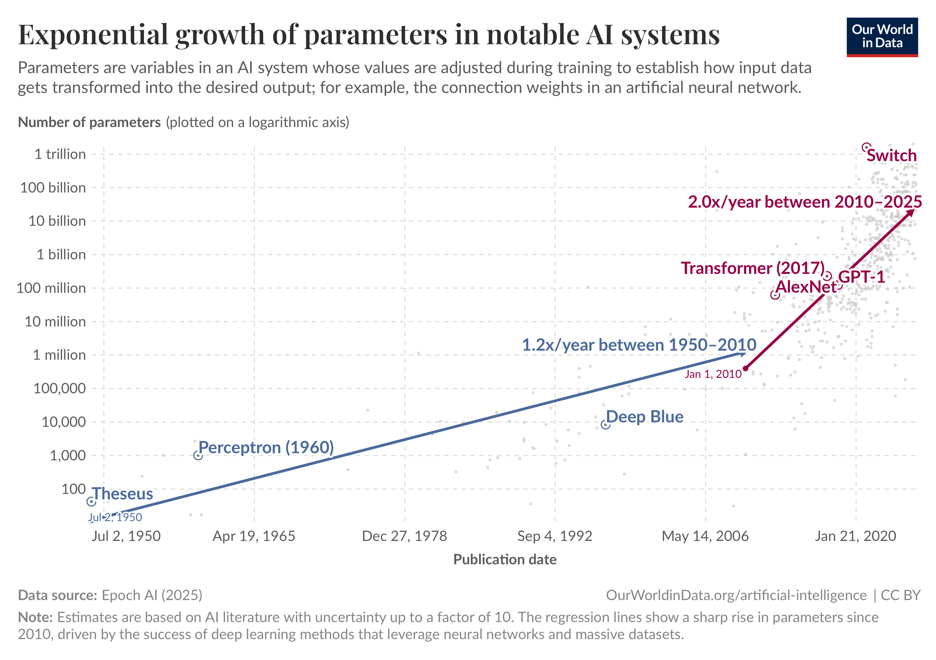
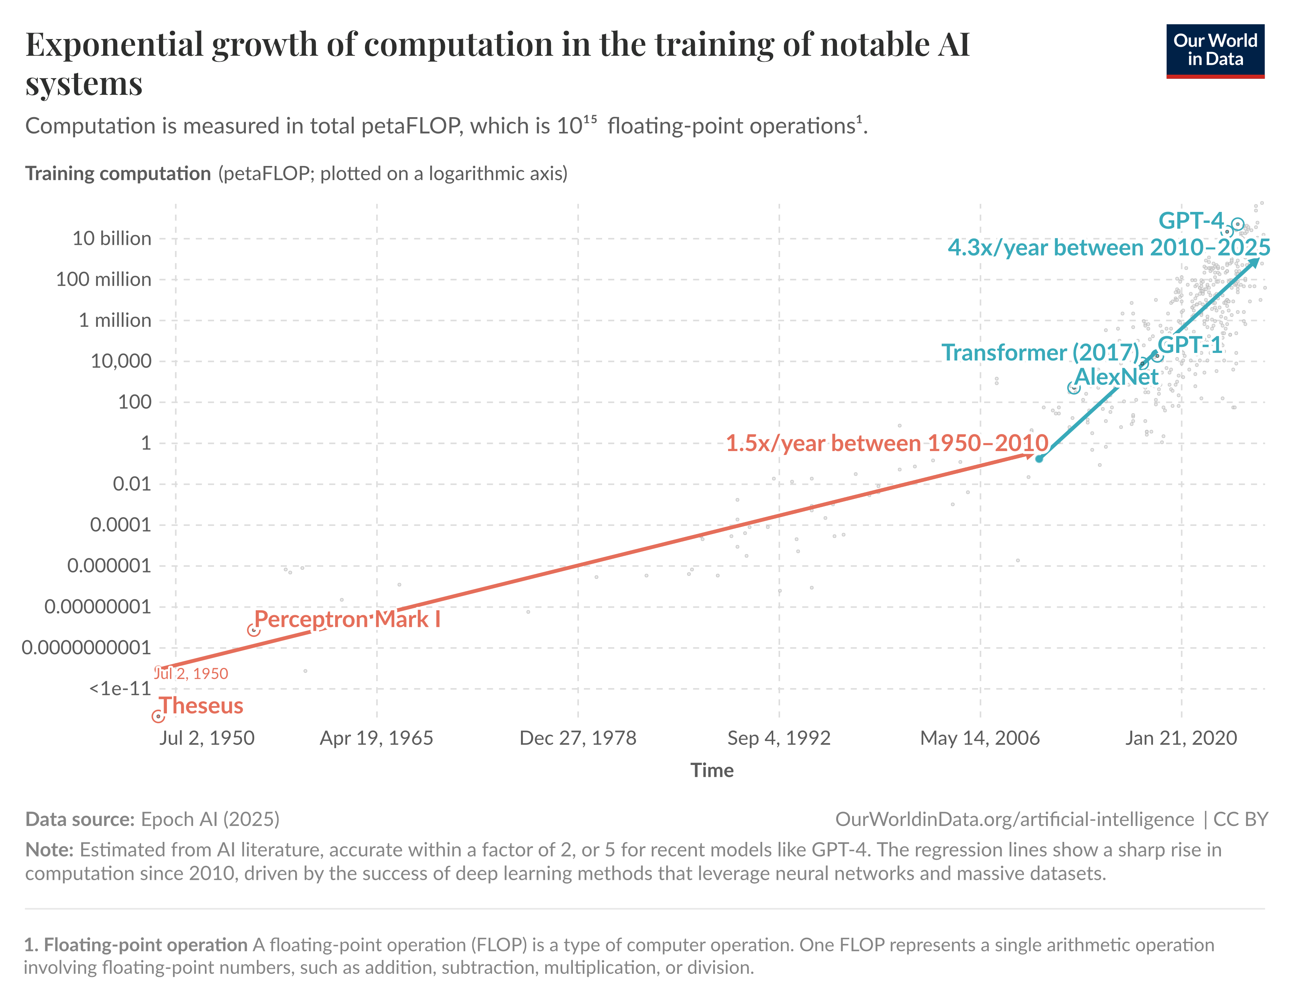
Motivation: Scalable AI Nowadays
Why scaling matters?
Bigger AI systems, trained on more data and using more computational resources, tend to perform better. (even without substantial changes to the algorithms)
Parameter growth exponentially!
Computation growth exponentially!
Data source: https://ourworldindata.org/scaling-up-ai
3

Slide 4
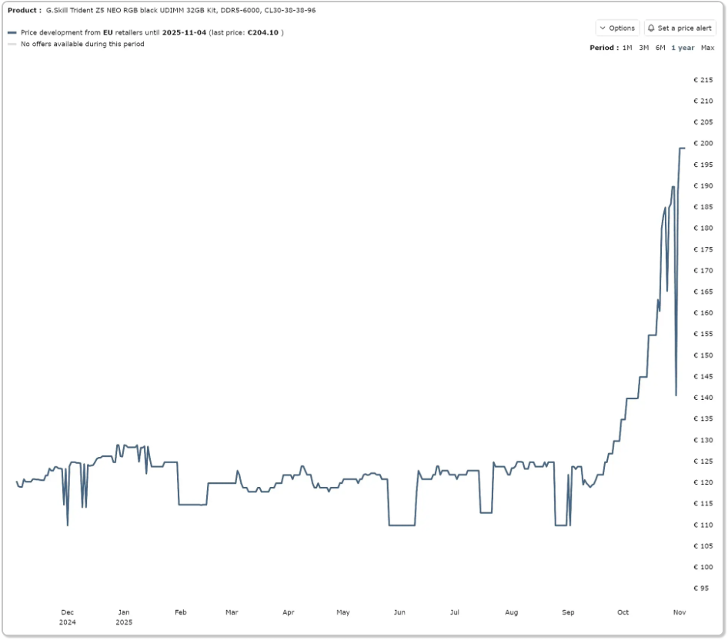
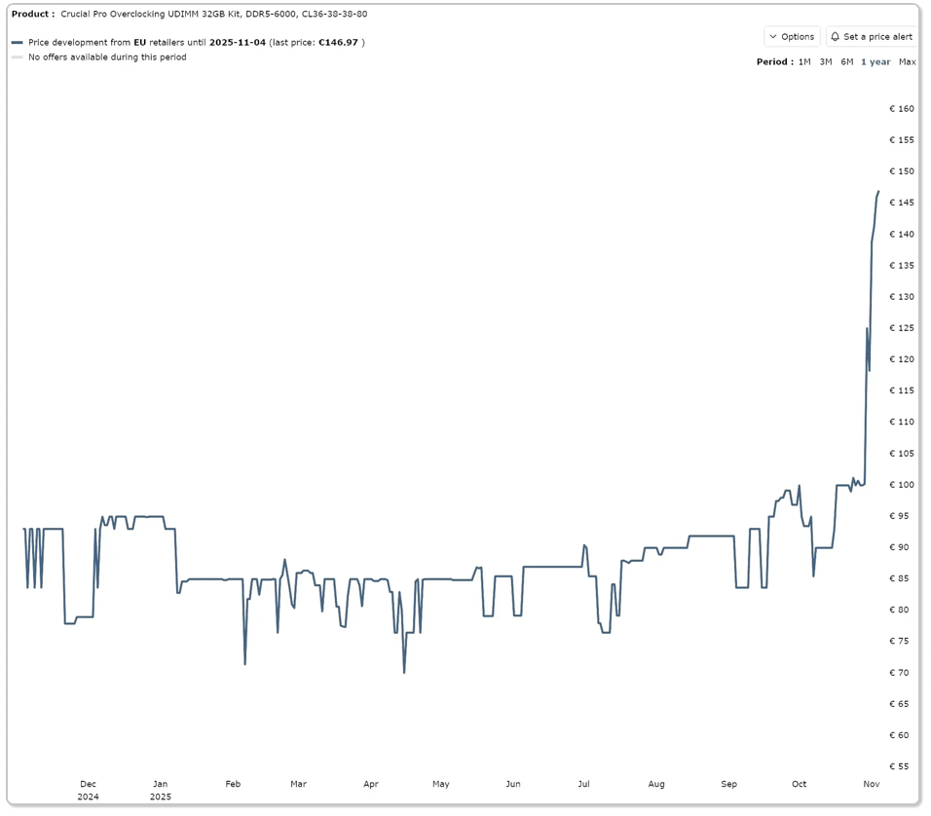

Motivation: Energy&Storage-hungry AI Dev.
Why scaling harms?
Scaling AI models dramatically increases energy consumption and storage needs.
4

Slide 5
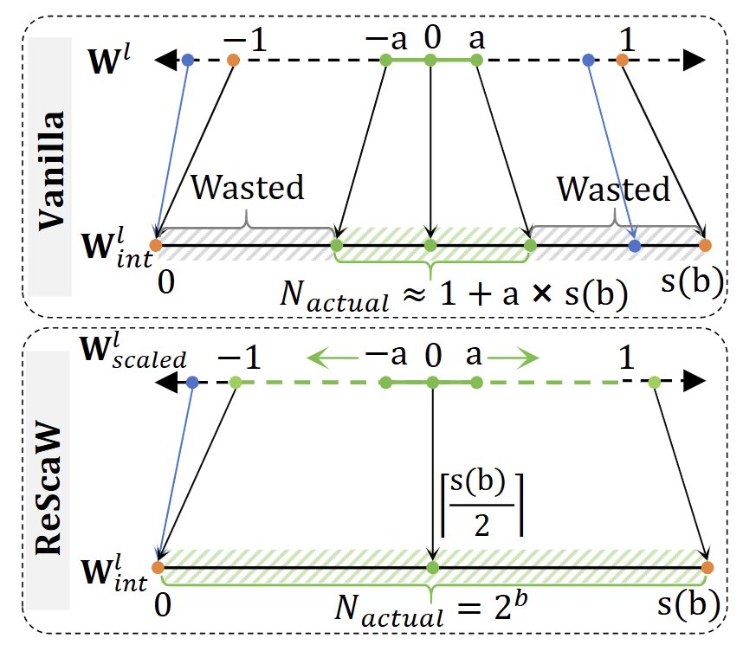
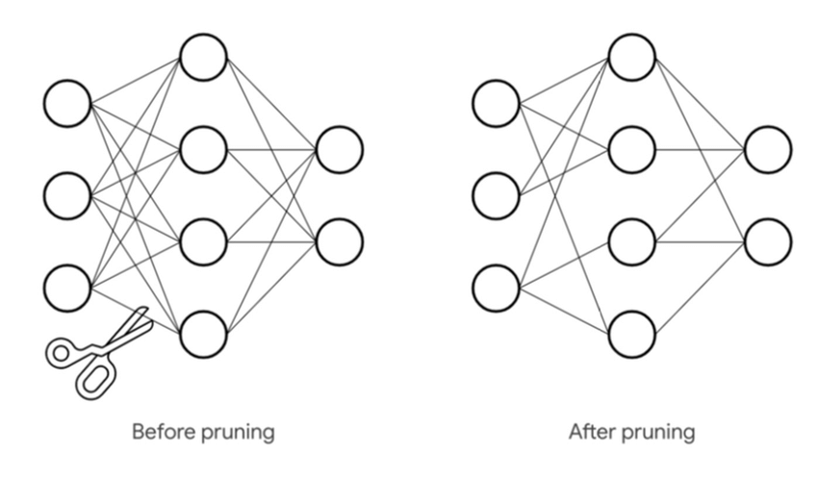
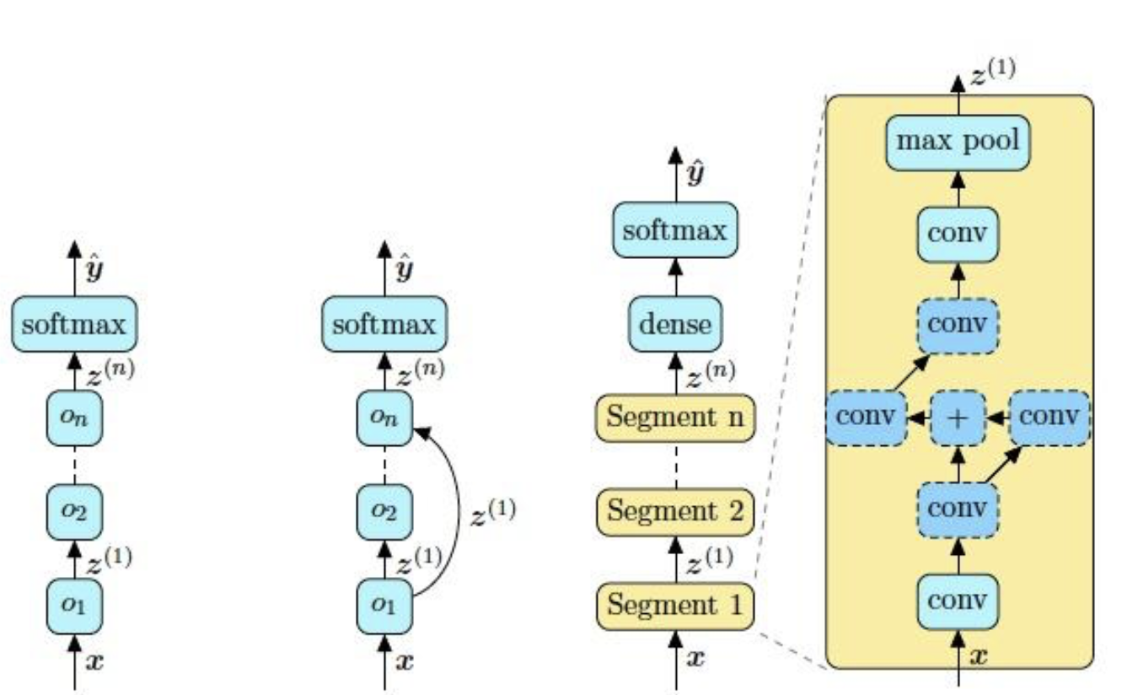
Motivation: Lightweight Neural Networks
In model arch., what do we focus on?
Arch. Searching
Quantization
Pruning
5

Slide 6
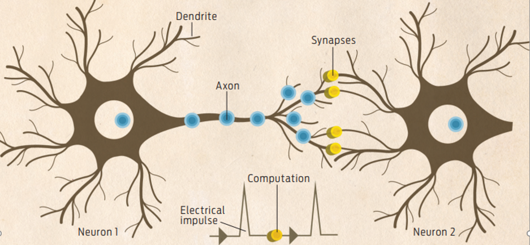
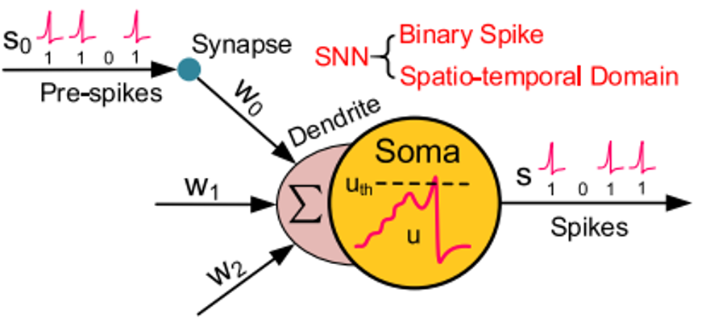
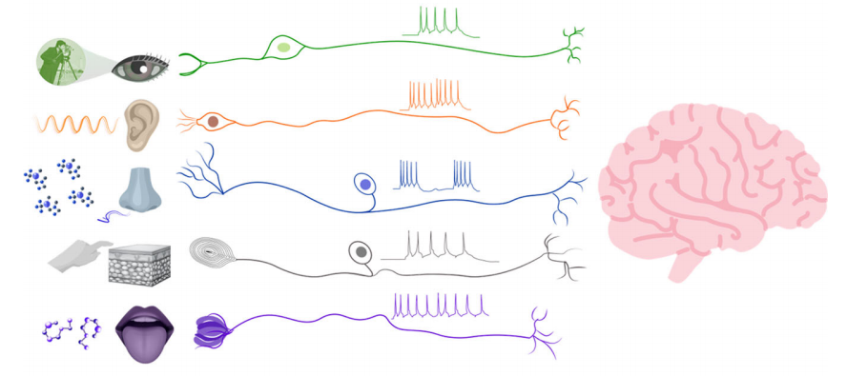
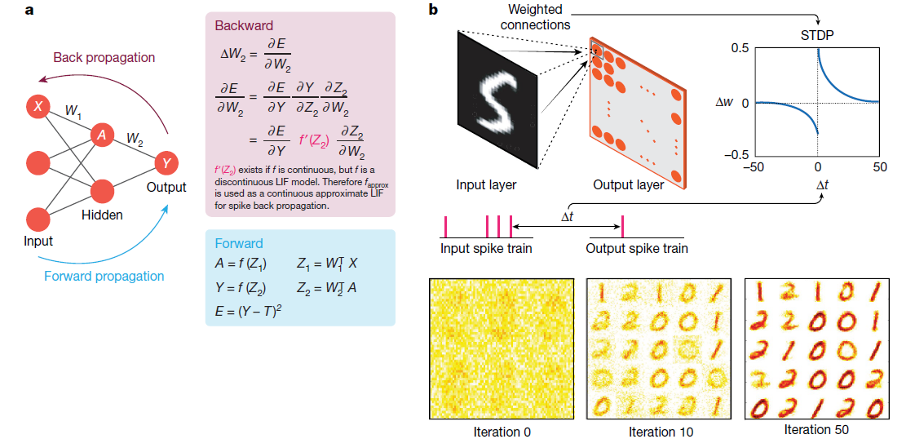
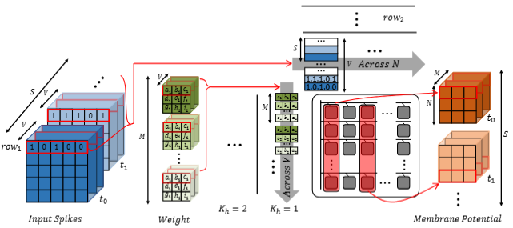
Motivation: Energy-saving Neural Networks
In model arch., what do we focus on?
Biological neurons
Spiking neurons
Encoding?
Training Alg.？
Bio-inspired Computing
Model Arch.？
Hardware？
6

Slide 7
Contents
1. Motivation
2.1. Hardware Background
2. Quick Glance of Quantization
2.2. Uniform Affine Quantization
3. Proposed Method
2.3. Symmetric Uniform Quantization
4. Experiments
2.4. PTQ & QAT
5. Conclusion
2.5. Backward Path for QAT
7

Slide 8
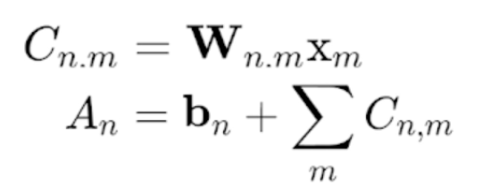
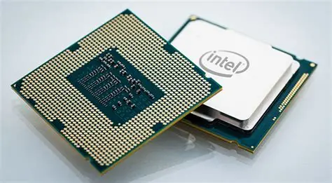
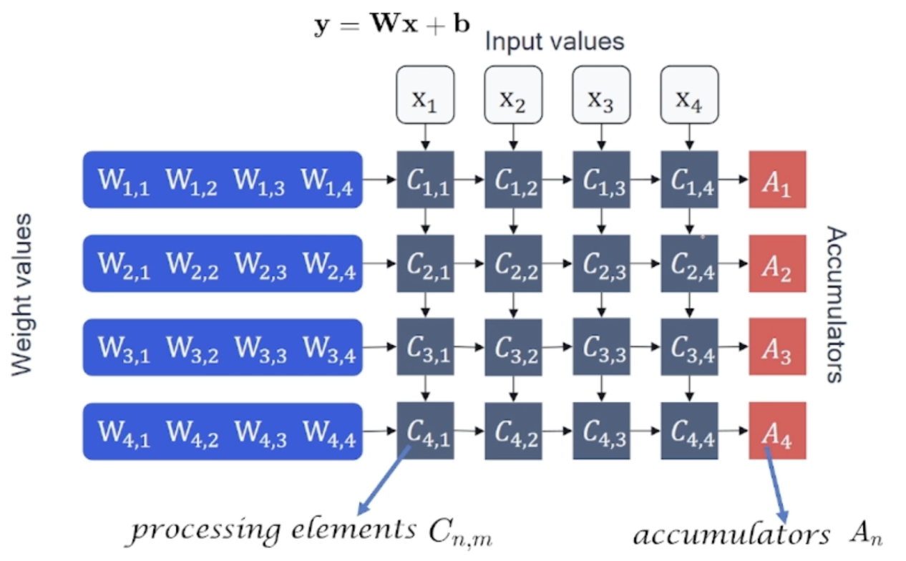
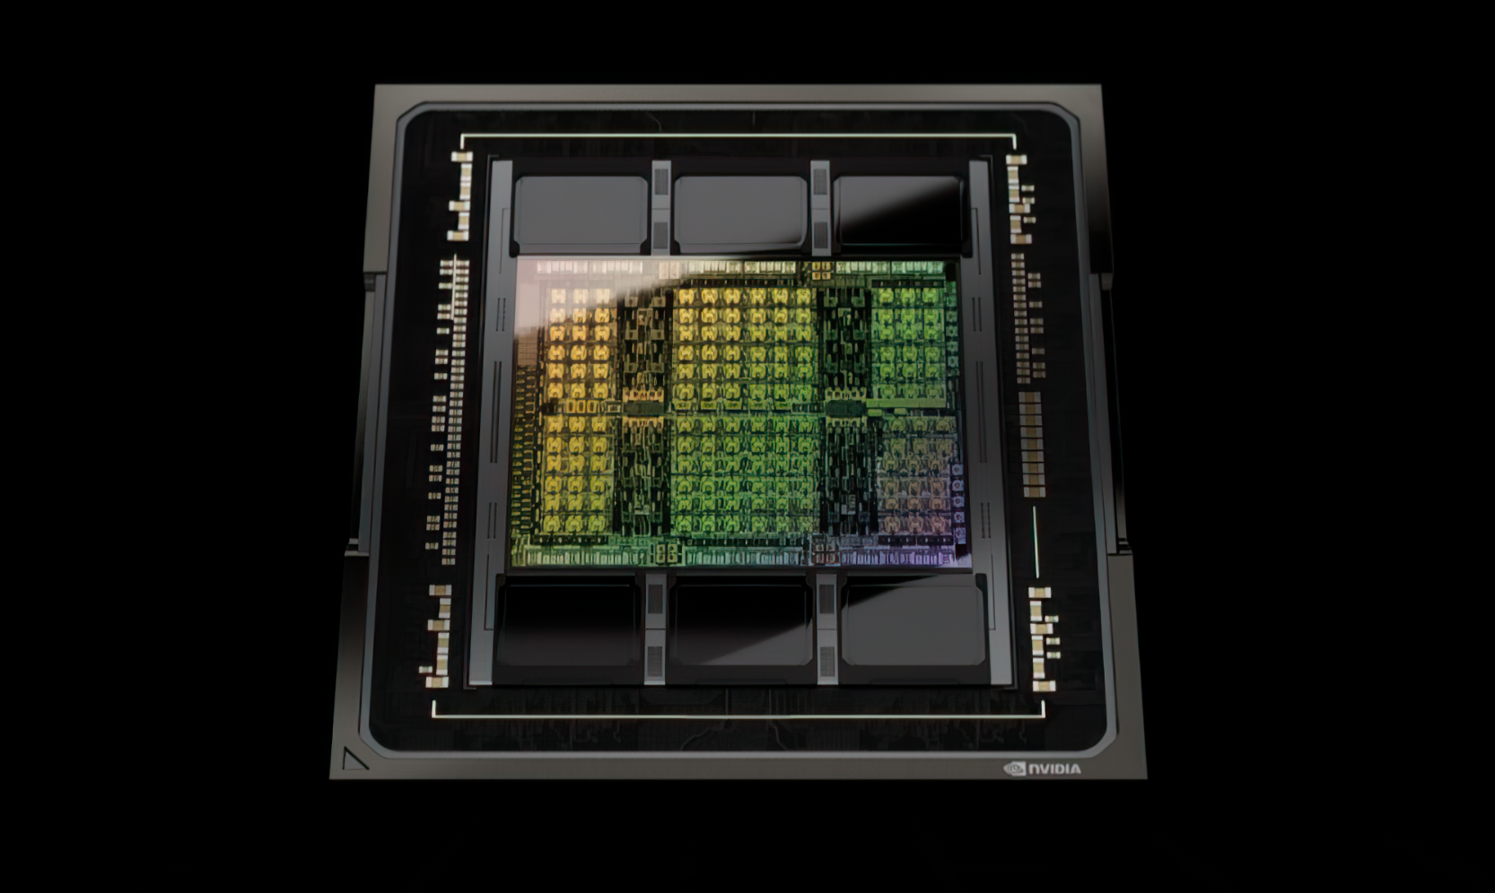
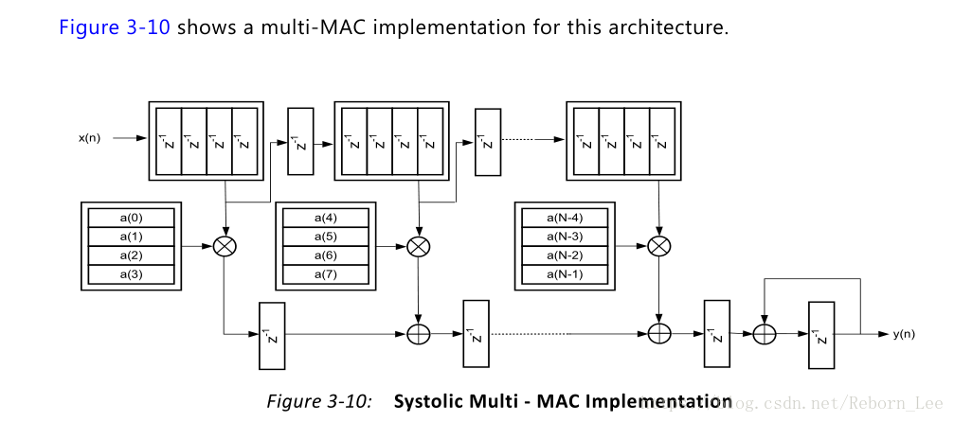
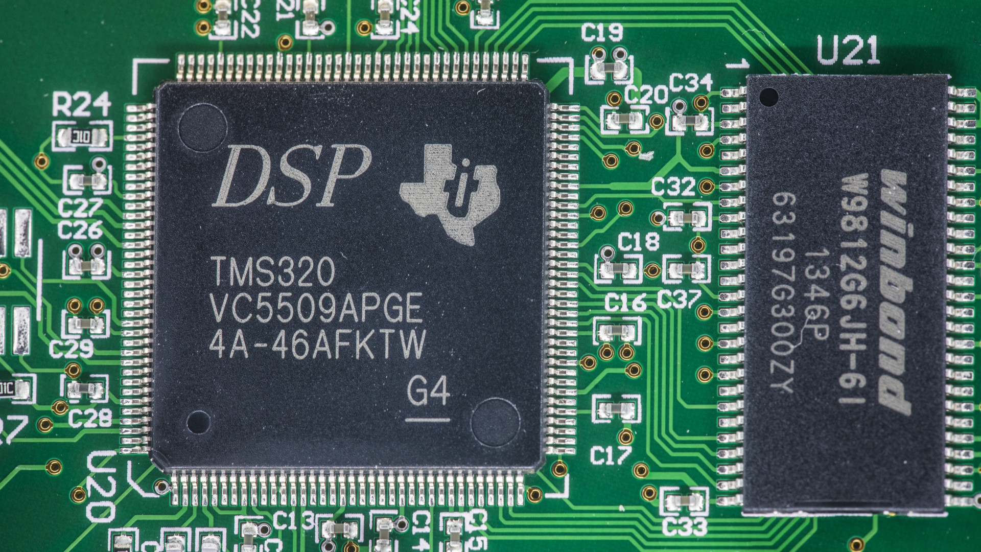
Quick Glance of Quantization
Hardware Background
Multiply-accumulate structure(MAC)
ALU in CPUs
SM Core in (Nvidia)GPUs
Elastic FPGAs
Programmable DSPs
8

Slide 9
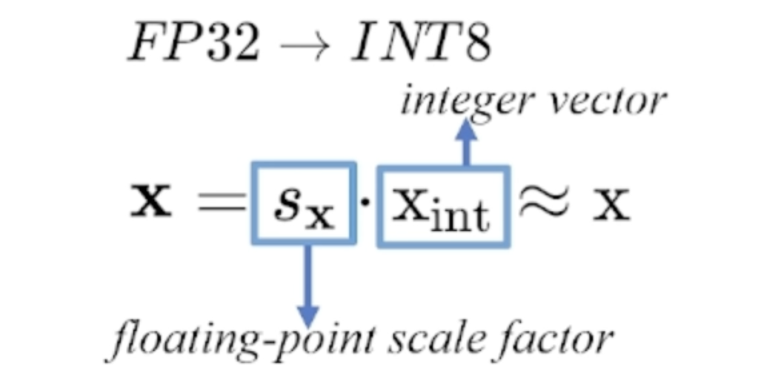
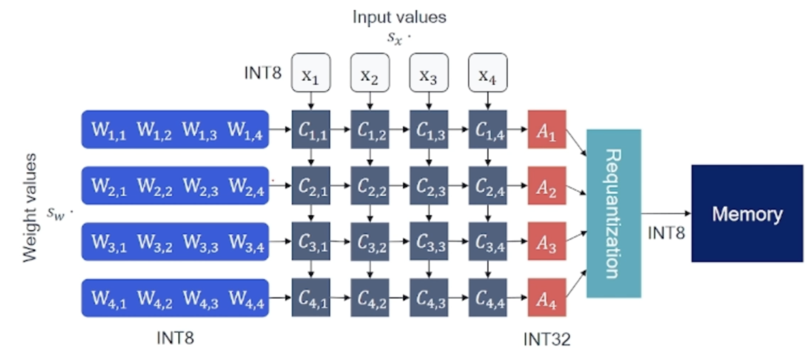
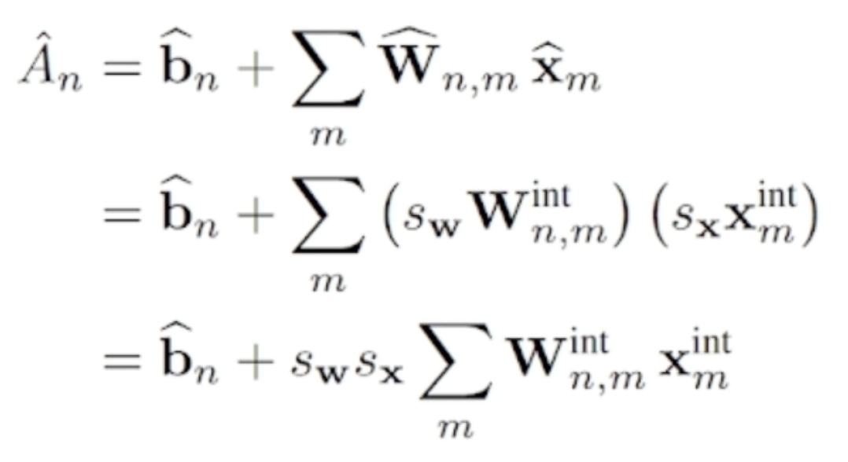
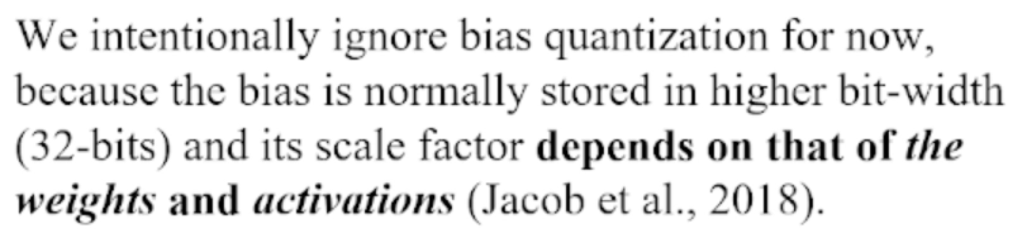
Quick Glance of Quantization
9

Slide 10
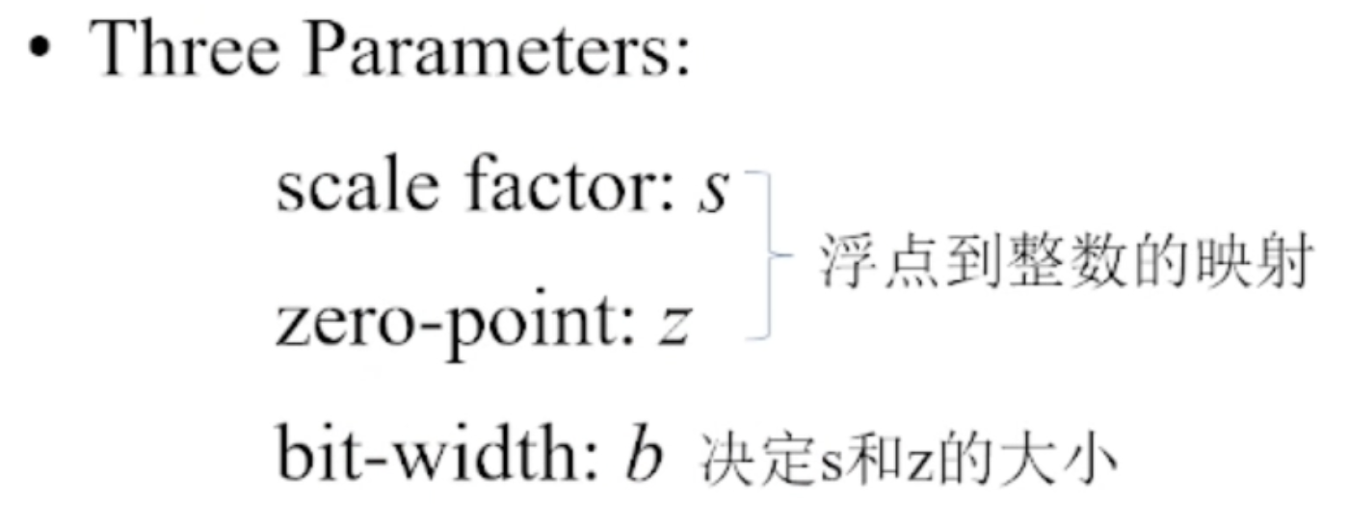
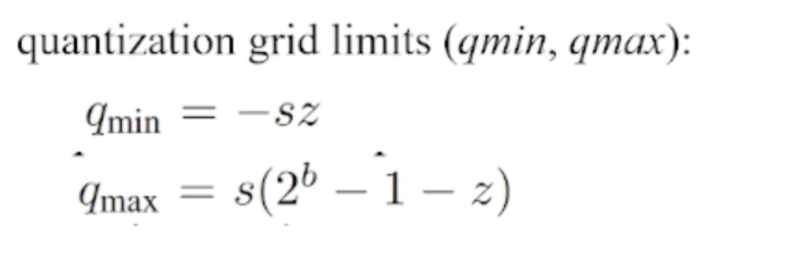
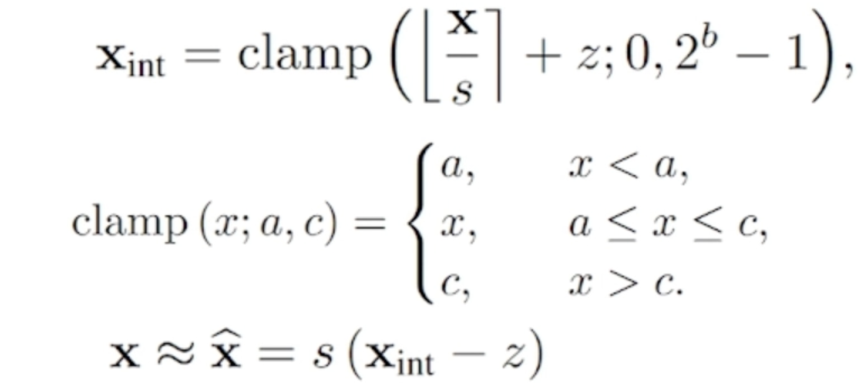
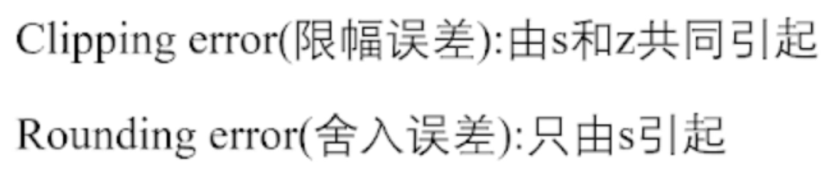
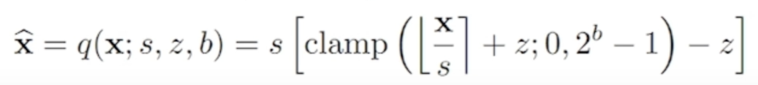
Quick Glance of Quantization
Uniform Affine Quantization
10

Slide 11
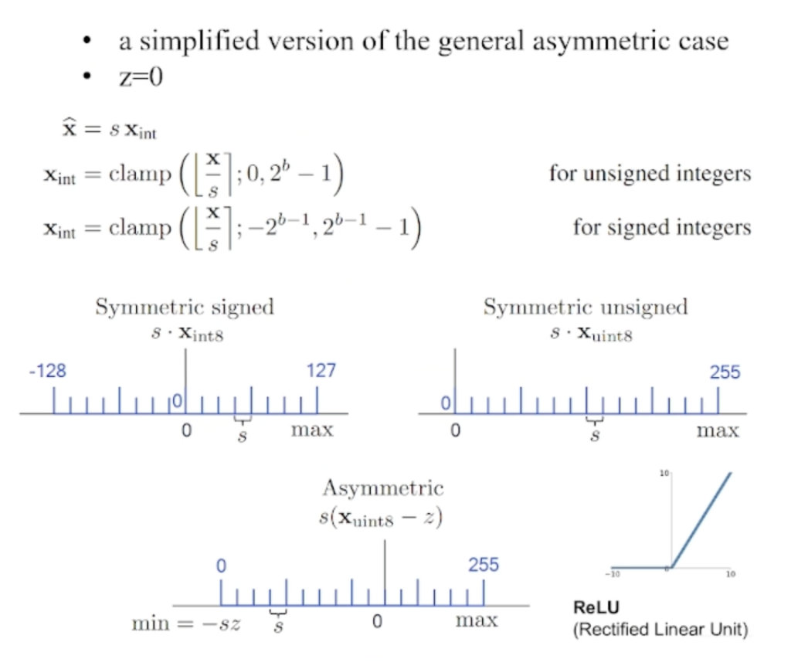
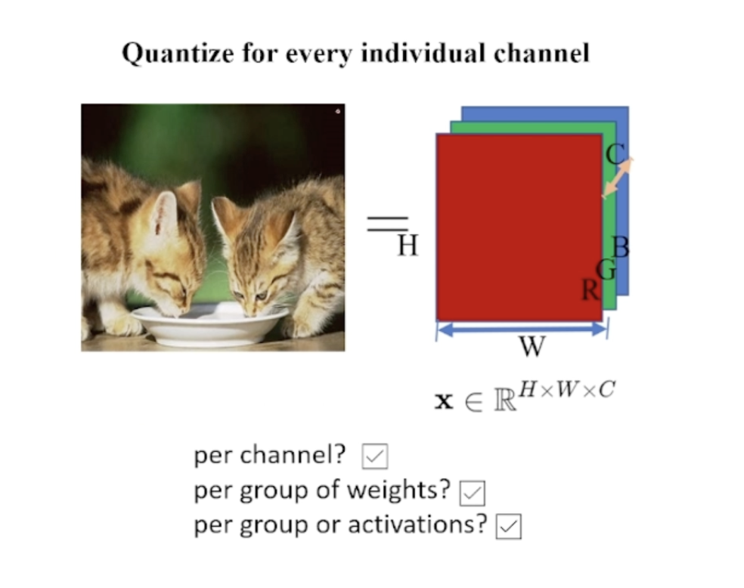
Quick Glance of Quantization
Symmetric Uniform Quantization
Quantization Granularity:

Slide 12
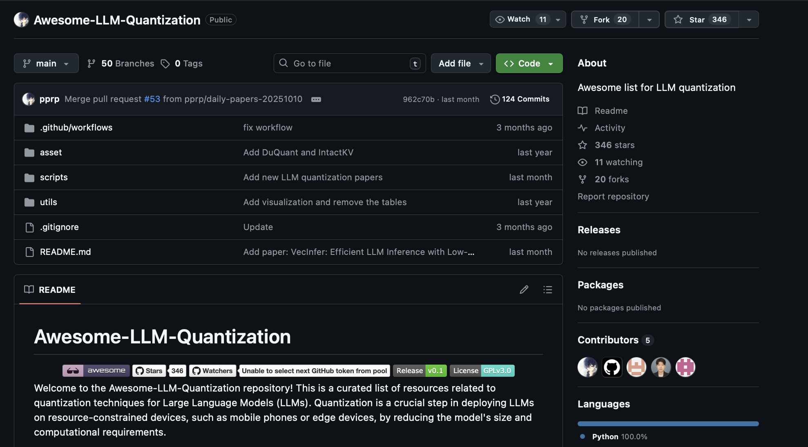
Quick Glance of Quantization
PTQ & QAT
PTQ: Post-training quantization
Most common used in large model quantization
QAT: Quantization-aware training
Tend to maintain the performance while introducing [fake] quantizing process.

Slide 13
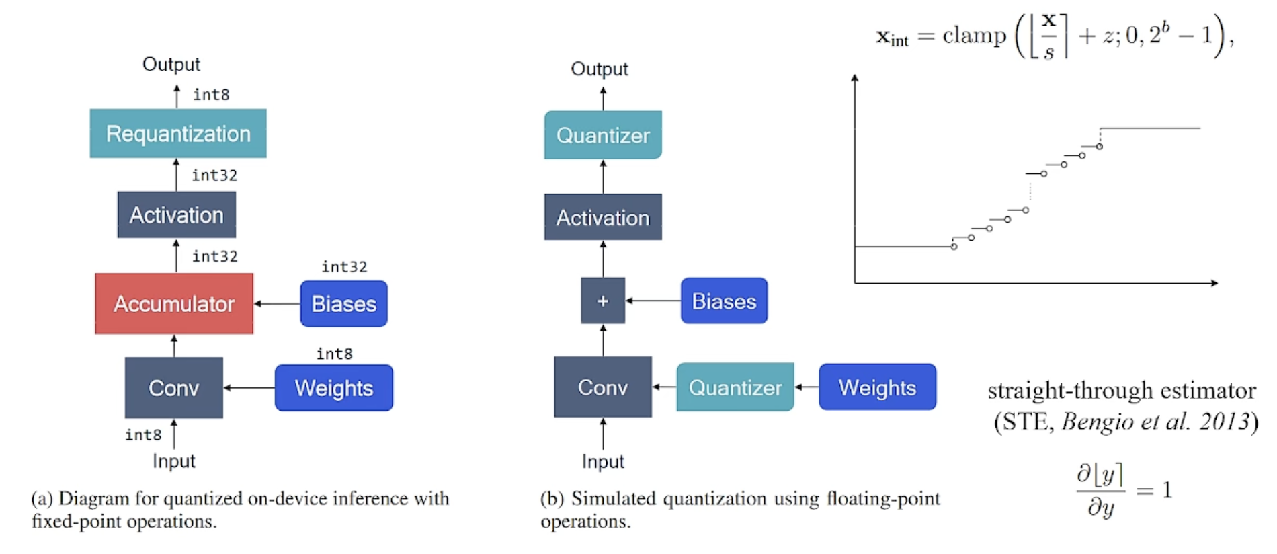
Quick Glance of Quantization
Backward Path for QAT

Slide 14
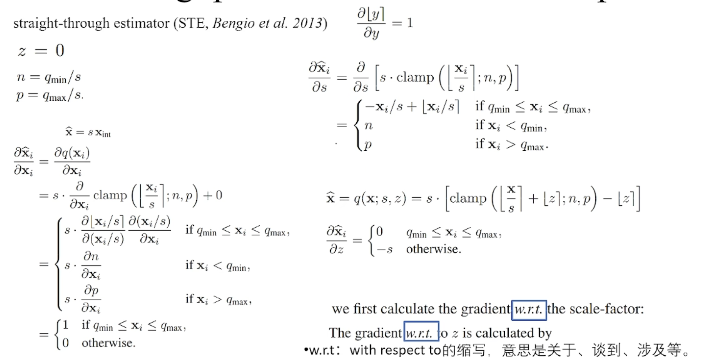

Quick Glance of Quantization
Backward Path for QAT

Slide 15
Contents
1. Motivation
3.1. Quantization Baseline Model
2. Quick Glance of Quantization
3.2. Spike Information Distortion
3. Proposed Method
3.3. Information-enhanced LIF
4. Experiments
3.4. Fine-grained Distillation
5. Conclusion
15

Slide 16
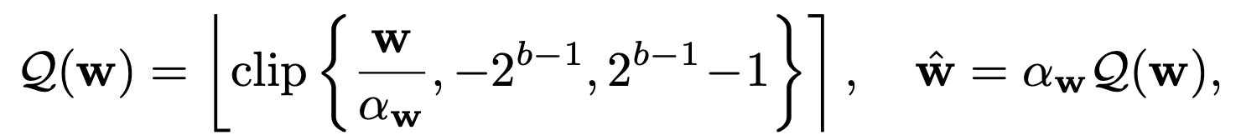
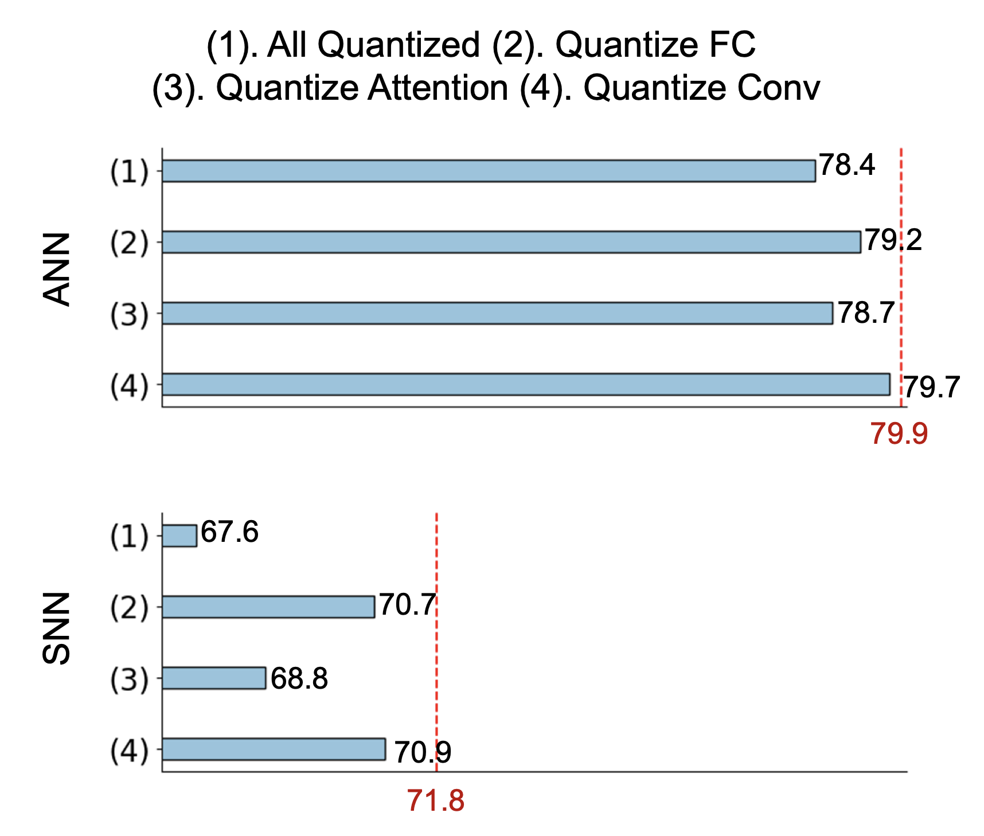
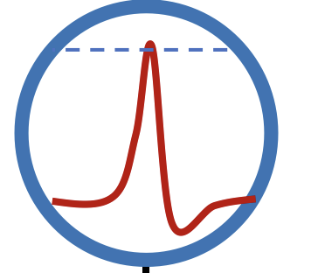
Proposed Method
Quantization Baseline Spiking Transformer Model
SNN networks are more sensitive to balance the efficiency and performance.
The Attention is the most sensitive part in Spiking transformers
FC/Conv
Norm

Slide 17
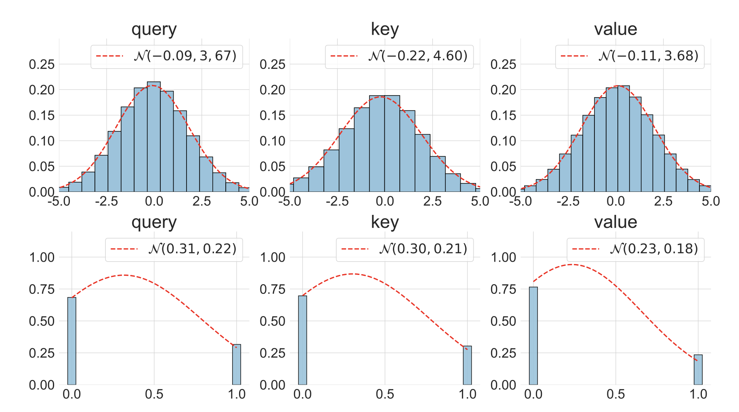
Proposed Method
Quantization Baseline Spiking Transformer Model
bimodal distribution in SNN and normal distribution in ANN
the information representation capability of the Q-SDSA is severely limited compared to that of ANNs.

Slide 18
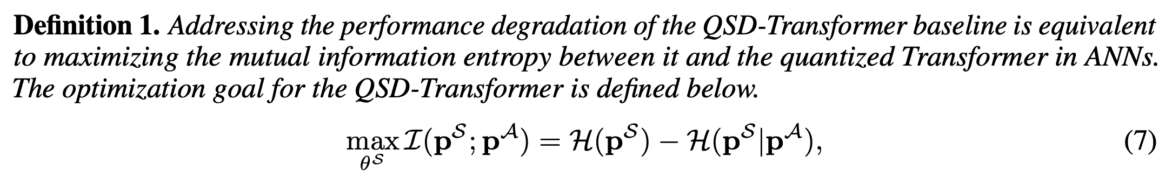
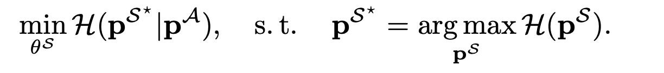
Proposed Method
Spike Information Distortion
Attention score in quantized spiking Transformer
Attention score in quantized Transformer
A bi-level optimization problem:

Slide 19
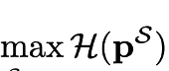
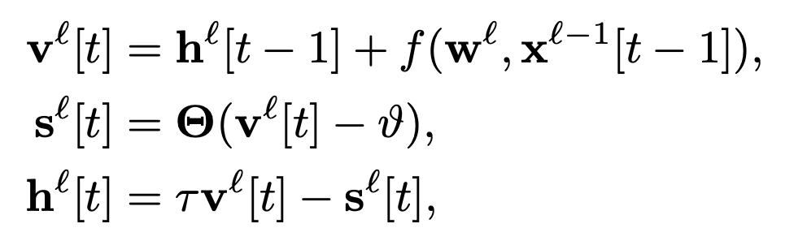
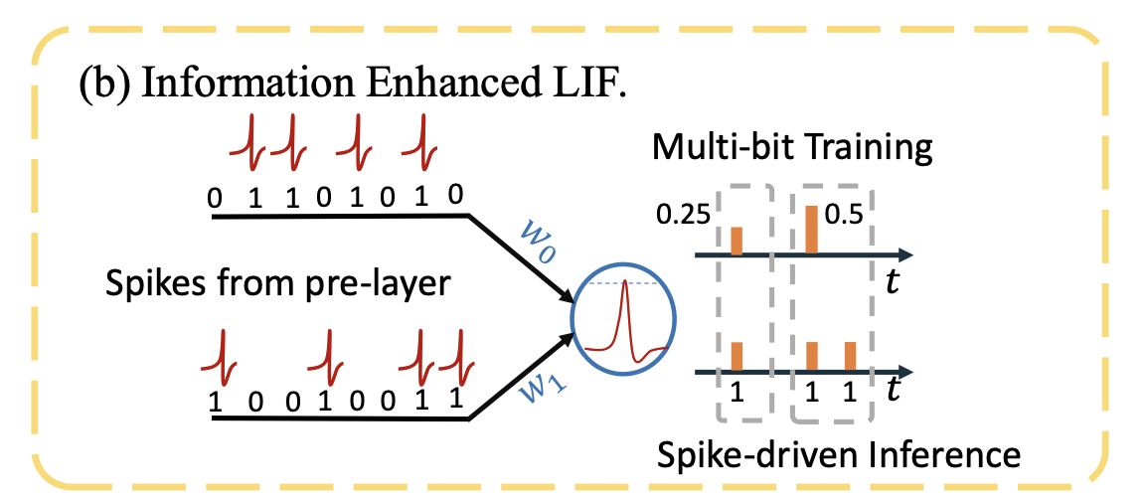
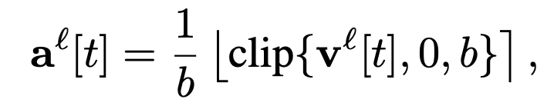
Proposed Method
Low-level: Information-enhanced LIF

Slide 20
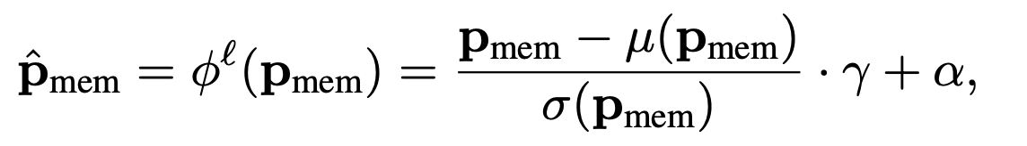

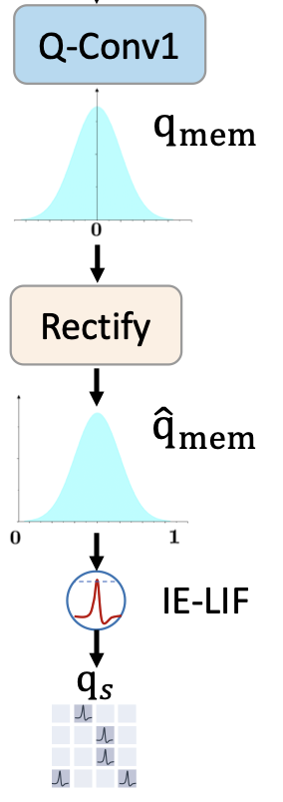
Proposed Method
Low-level: Information-enhanced LIF
membrane potential rectify function (MPRF)

Slide 21
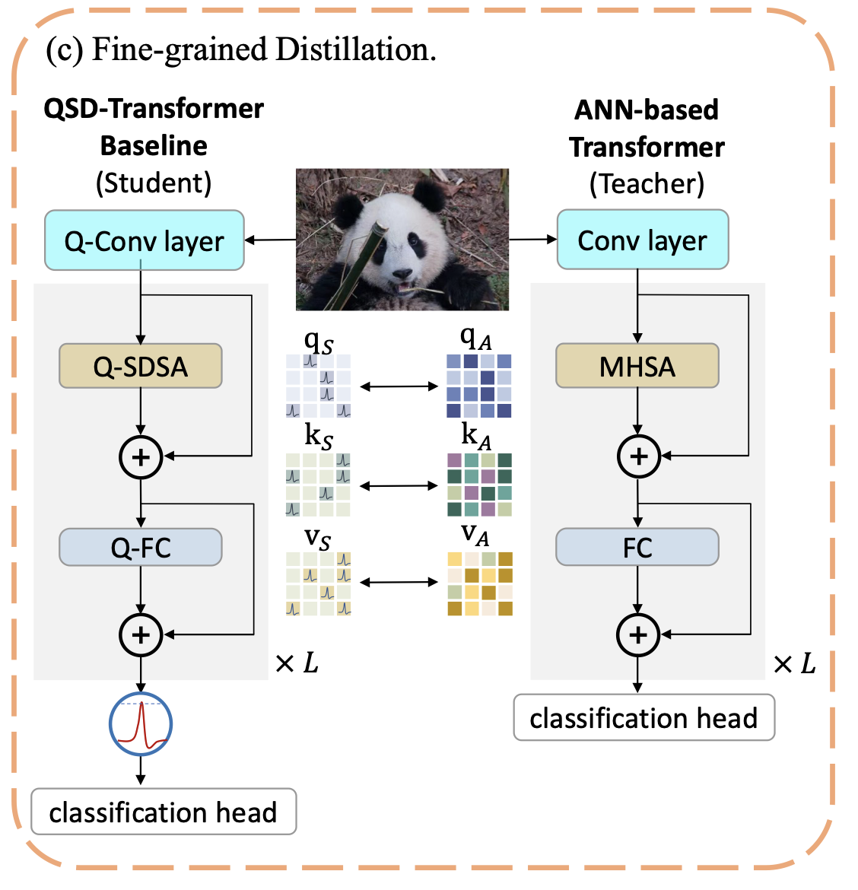
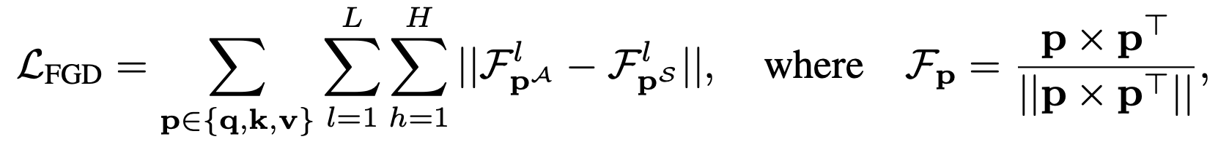
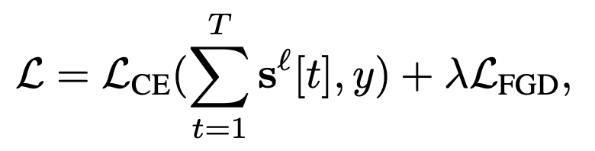
Proposed Method
High-level: Fine-grained Distillation

Slide 22
Contents
1. Motivation
4.1. ImageNet-1k Classification
2. Quick Glance of Quantization
3. Proposed Method
4.2. COCO 2017 Object Detection
4. Experiments
4.3. ADE20K Semantic Segmentation
5. Conclusion
4.4. CIFAR Transfer Learning
4.5. Ablation Study
22

Slide 23
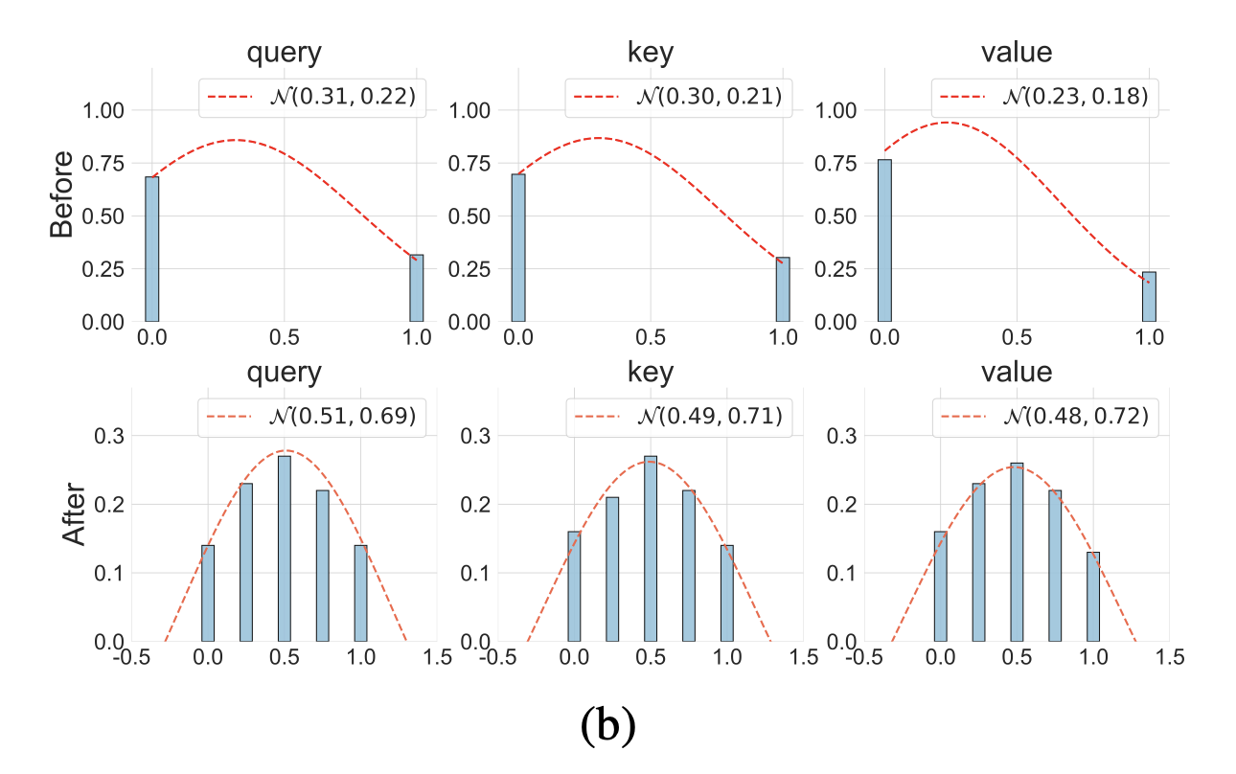
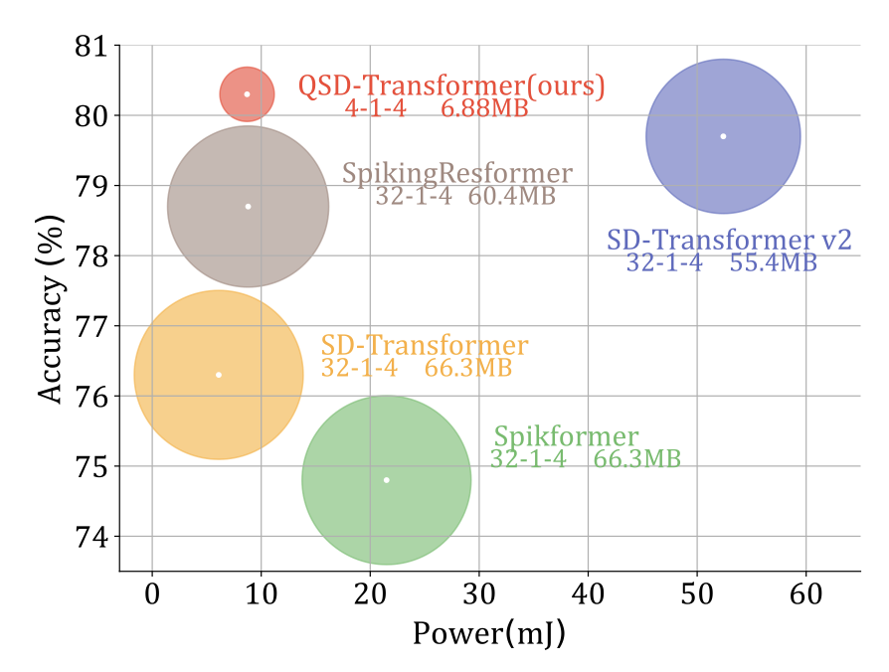
Experiments
ImageNet-1k Classification

Slide 24
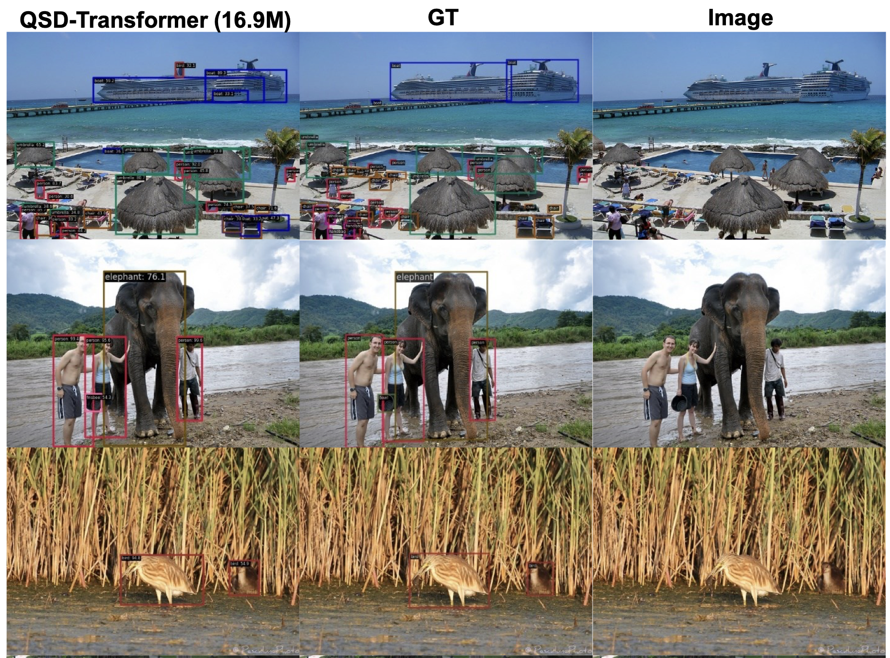

Experiments
COCO 2017 Object Detection

Slide 25


Experiments
ADE20K Semantic Segmentation

Slide 26

Experiments
CIFAR Transfer Learning

Slide 27

Experiments
Ablation Study

Slide 28
Contents
1. Motivation
2. Quick Glance of Quantization
3. Proposed Method
4. Experiments
5.1. Works on Quantized SNNs
5. Conclusion
5.2. Works on Software-Hardware Co-design
28

Slide 29
Conclusion
Overall, we achieved：
The first and SOTA work of quantized spike-driven transformer.
Proposed a new training paradigm for spiking neural networks (Multi-bit training—Binary inference).
Widely validation across computer vision tasks: Classification/Detection/Segmentation…
Supported further deployment on edge devices in the aspect of algorithm.

Slide 30
Conclusion
Compressed Spiking Neural Network Series：
[1] Q-SNNs: Quantized Spiking Neural Networks (ACM MM25’)
[2] Quantized Spike-driven Transformer (ICLR25’)
[3] QP-SNN: Quantized and Pruned Spiking Neural Networks (ICLR25’)
[4] S²NN: Sub-bit Spiking Neural Networks (NIPS25’)
[5] Binary Event-Driven Spiking Transformer (IJCAI25’)

Slide 31

Conclusion
Software-Hardware Co-design for Brain-inspired Computing

